Slide 1
DATABASE MANAGEMENT SYSTEMS LAB
HOTEL MANAGEMENT SYSTEM
Group Members:
NIMRA MUSKAN CS211181
NEHAL USMAN CS211179
M SHAHMEER CS211092

Slide 2
Sign up
Sign up
customer
Log in
login
no
Logged in
Show
check
view
View menu
Show
category
order
order
Generate bill
yes

Slide 3
firstName
lastName
password
customer
can
can
View menu
has
S.No
id
Name
order
has
foodItem
name
price
price

Slide 4
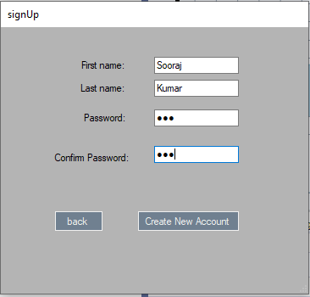
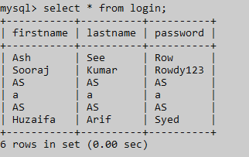
INSERT INTO hotelms.login(firstname,lastname,password) VALUES('" + fnametxt.Text + "','" + lnametxt.Text + "','" + passtxt.Text + "')";

Slide 5
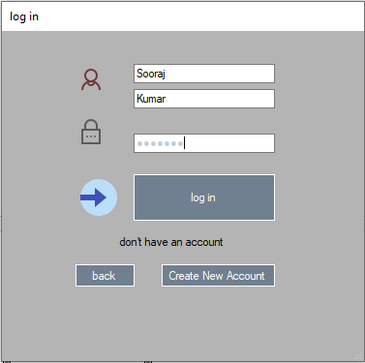
SELECT `firstname`,`lastname`,`password` FROM hotelms.login WHERE `firstname` = '" + fnametxt.Text + "' AND `lastname` = '" + lnametxt.Text + "' AND `password` = '" + passtxt.Text + "'";

Slide 6
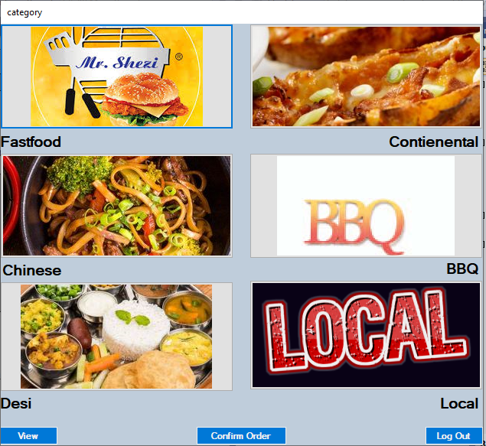
MENU

Slide 7
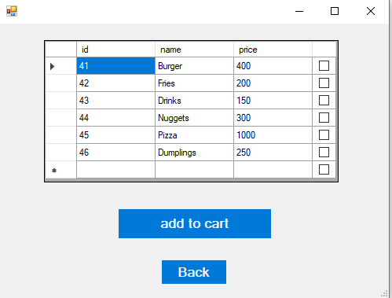
As all columns are graphically same , that’s why showing only 1st one.
SELECT * FROM hotelms.fastfood;

Slide 8
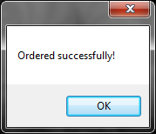
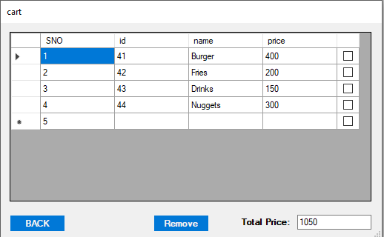
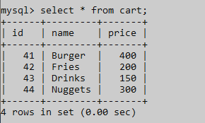
INSERT INTO hotelms.cart values(@id,@name,@price);

Slide 9
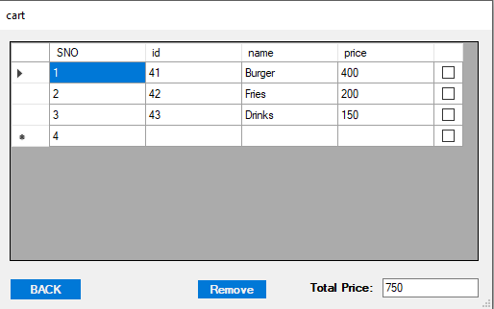
DELETE from hotelms.cart WHERE id ='" + item.Cells[1].Value.ToString() + "';

Slide 10
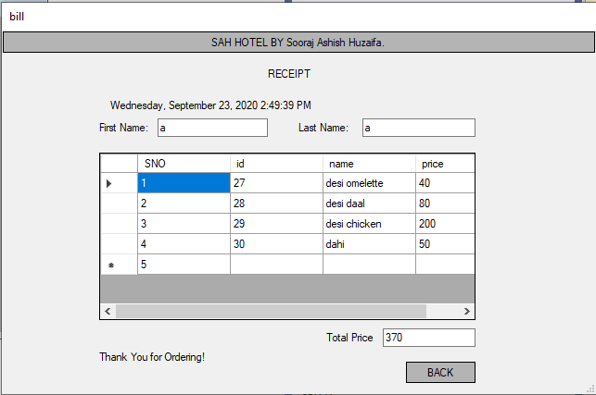
Final Bill when we’re done with our order.
SELECT sum(price) as Total from hotelms.cart

Slide 11
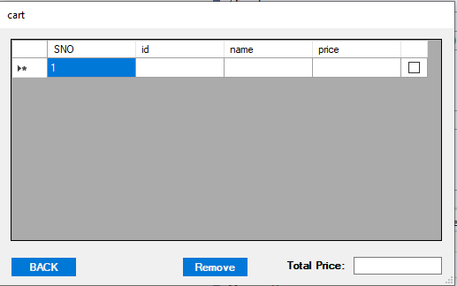

TRUNCATE TABLE hotelms.cart

